Slide 1

CHC Leader Development Framework

Slide 2
Lesson 1 – The Five dysfunctions of a team
Lesson 2 – Conflict Management
Lesson 3 – Leadership Blind Spots
Lesson 4 – The Power of Transparency
Lesson 5 – A Culture of Accountability
Lesson 6 – The Science of Character
Lesson 7 – The character of collaboration
Lesson 8 – The character of toughness
Lesson 9 – The character of connection
Lesson 10 – Called to Serve

Slide 3
The Five Dysfunctions of a Team
Session - 1
The intent of this session is to explore the “character” of a team and to have a transparent conversation on the requirements to build a winning command.
1. Think about the most cohesive team you have been apart. With that in mind, have a discussion on the attributes that contributed to the success of the unit. Have a spokesperson to write the traits on a board.

Slide 4
2. View the following clip that explains the five dysfunctions of a team.
https://www.youtube.com/watch?v=GCxct4CR-To&spfreload=10
In your own words, define trust and select an option that best describes your belief. Be sure to defend your logic.
  Trust is earned
  Trust is given
  Trust must be taken
Have a discussion on if trust can be rebuilt.
As a team, devise a model on how to build trust in RMTs.

Slide 5
3. In your own words, explain why there is fear of conflict in the workplace.
Is there a difference between healthy and unhealthy conflict in the workplace? Be sure to give examples.
As team devise a model to develop healthy conflict in the workplace.
4. One our core values is commitment. Take a few minutes and discuss the following:
What is commitment and a scale of 1 – 5 (5 being the highest) rate the commitment level of the average Naval command. Be sure to defend your logic.
Is possible to revitalize the commitment of those who are Retired On Active Duty (R.O.A.D)? If so how, if not why?

Slide 6
5. Go around the room and provide your understanding of the word – Accountability.
Based on this definition, is anyone above accountability? Defend your answer with examples
What are some practical ways to hold ourselves more accountable?
6. The final dysfunction of a team revolves around results. Why do you believe results are so important?
Can a team produce an unethical result? Explain.
How can RMTs help commands produce ethical results?

Slide 7
Conflict Management
Session - 2
The intent of this session is to introduce the learner to their preferred method of dealing with conflict. This self-awareness will help empower teams to confront conflict in a more constructive manner.
1. Prior to the session, each participant should view the following Ted Talk:
https://www.youtube.com/watch?v=F6Zg65eK9XU

Slide 8
First and foremost, workers at all levels must learn to accept conflict as an inevitable part of their work environment – the study found that an overwhelming majority (85%) of employees at all levels experience conflict to some degree. Furthermore, we found that U.S. employees spend 2.8 hours per week dealing with conflict, equating to approximately $359 billion in paid hours in 2008. The question for management, therefore, is not whether it can be avoided or mitigated; the real concern is how conflict is dealt with. If managed improperly, businesses’ productivity, operational effectiveness, and morale take a major hit, as evidenced in our finding that 27 percent of employees have witnessed conflict morph into a personal attack, while 25 percent say that the avoidance of conflict resulted in sickness or absence from work.
As you think about the above quote from CPP’s Global Workplace Conflict Report, how can unresolved conflict impact a military environment?

Slide 9
2. While reflecting on the Ted Talk, have a conversation on the following:
The presenter mentioned the words of a mentor that helped confront his conflict management style. Team up with someone and share the following:
  Define conflict and explain if conflict is a bad thing.
  When and how did you discover your style of conflict management?
  Describe your conflict management style.
  In your discussion be sure to provide a “successful” and “unsuccessful” outcome of your style of conflict management.
  Does your method apply to your personal as well as professional? Explain.
Go around the room and allow the team to share if they desire.

Slide 10

Review The Forms of Conflict
Conflict exists when one person has a perceived need of another and that need is NOT being met.
Functional Conflict – a confrontation between groups that enhances and benefits the organization’s performance.
Dysfunctional Conflict – a confrontation or interaction between groups that harms the organizations and hinders productivity.1
1 Organizational Behavior & Management; Jonh M. Invancevich, Robert Konopaske & Michael T. Matteson

Slide 11
Please review the five different styles of conflict resolution. After reviewing the styles, honestly respond the following questions on the next slide by
Accommodating
Allowing others
to win
Collaborating
Working together to solve problems
Compromising
Finding acceptable solution so everyone feels good
Avoiding
Ignoring or steering clear of others
Competing
Working to dominate and control

Slide 12
Conflict Style Survey
1=Never, 2 Rarely, 3=sometimes
4=Often, 5=Very Often
I work to come out victorious, no matter what.
I try to put the needs of others above my own.
I look for mutually satisfactory solutions.
I try not to get involved in conflicts
I strive to investigate issues thoroughly and jointly.

Slide 13
Conflict Style Survey
1=Never, 2 Rarely, 3=sometimes
4=Often, 5=Very Often
I never back away from a good argument.
I strive to foster harmony.
I negotiate to get a portion of what I propose.
I avoid open discussions of provocative subjects.
I openly share information with others in resolving disagreements.
Use the scale on the next slide to determine your conflict style.

Slide 14
Conflict Style Score Card
Competitor = Q1__ + Q6___ = Total___
Collaborator = Q5__ + Q10___ = Total___
Avoider = Q4__ + Q9___ = Total___
Accommodator = Q2__ + Q7___ = Total___
Compromiser = Q3__ + Q8___ = Total___
The largest number represents your style
Bargaining Styles and Negotiation: The Thomas-Kilmann Conflict Mode Instrument in Negotiation Training. G. Richard Shell (April 2001)

Slide 15
3. Review the five styles of conflict management and discuss the following:
What would be the pros and cons of each conflict management style in leadership?
The Ted-Talk presenter mentioned three responses in the face of conflict (a) Fight, (b) Freeze and (c) Flee. Discuss the pros and cons of each.
What role does an apology play in conflict. Please provide examples.

Slide 16
Leadership Blind Spots
Session - 3
The intent of this session is to expose leaders to their “blind spots” and to outline practical steps to help mitigate them.
1. When you think about the term leadership blind spots, what comes to mind and why? Break up in small groups and have a discussion. Share your thoughts with the team.

Slide 17
2. Take a few moments and review the following clip:
https://www.youtube.com/watch?v=5k97oEmbSoE&pbjreload=10
In your own words, describe the four leadership behaviors that can help bring the best out of a team. Go around the room and explain which one resonates the most with you and why.
In the book, Why CEOs Fail, the author contends that “…two-thirds of the people currently in leadership positions in the western world will fail; they will then be fired, demoted, or kicked upstairs. The most common reason for their failure will be due to blind spots.” What are your thoughts on this statement?

Slide 18
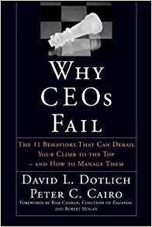
The Top Leadership Blind Spots
Arrogance
Melodrama (has to be the center of attention)
Moodiness
Indecisiveness
Habitual Distrust
Aloofneess
7. Rules don’t apply to me
8. Being a Maverick
9. Passive Aggressive
10. Perfectionism
11. People pleaser
In small groups, (1) identify the top three leadership blind spots in the CHC (2) explain how these blind spots are negatively impacting the community (3) what should be done to correct. Please be prepared to explain your answers to the larger group.

Slide 19
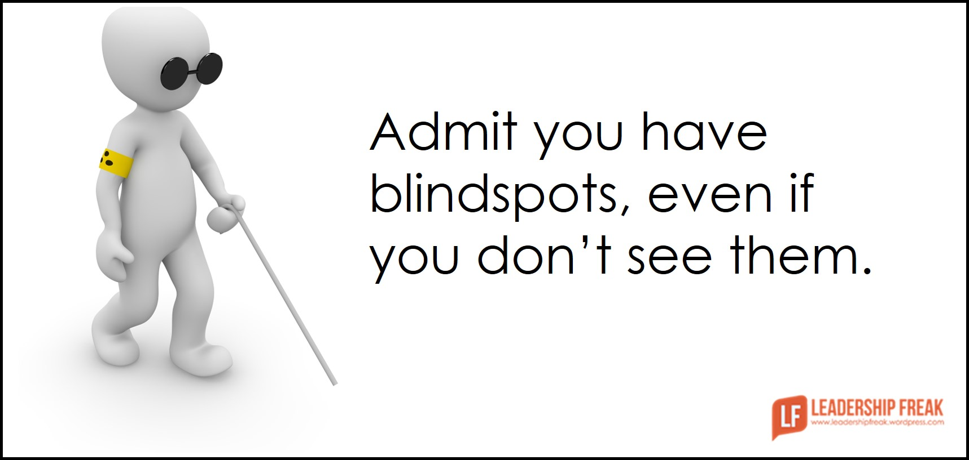
What are your blind spots?
We ALL have them
They are magnified when we are under stress
Our defense system will keep us from acknowledging our blind spots
“Yes” men/women will not be honest with you
Blind spots have always been there

Slide 20
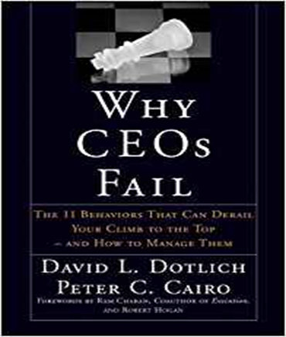
Detecting your blind spots exercise 1
Adversity analysis. Take 5 minutes alone and write done your biggest professional failures in your career. When complete answer the following questions:
What behaviors in these circumstances didn’t serve you well?
What would your worst critics say about how you acted?
Do you see a theme or pattern in your behaviors?
Do any of the leadership blind spots fit this pattern?

Slide 21
Detecting your blind spots exercise 2
Feedback. Give followers permission to respond to the following questions:
How can I be a better leader?
What do I do that make you nuts?
How do I force you to work around me rather than with me?
When you get together to complain about me, what do you complain about?
When I’m under stress, what do I do that you think is counterproductive?

Slide 22
Detecting your blind spots exercise 3
Find a Confidant. Ecclesiastes 4:12 reminds us that:
“Though one may be overpowered, two can defend themselves. A cord of three strands is not quickly broken.”
Take the risk and find a confidant that can help contain our blind spots. The team deserves that BEST of us!

Slide 23
Radical Transparency
Session - 4
The intent of this session is to explain a model for organizational transparency and strategize how it can be implemented in our respective commands.
In your own words, define transparency and select a statement that best represents your belief. (a) the average worker prefers transparency, (b) most workers can’t handle transparency (c) the lack of transparency slows down productivity.

Slide 24
2. What are the top reasons why some organizations don’t practice transparency.
https://www.youtube.com/watch?v=HXbsVbFAczg&pbjreload=10
3. After reviewing the above ted talk, explain your thoughts.
4. Ray Dalio is an advocate of allowing the best idea to “win”. Often arrogance or not “stress testing” thoughts are bypassed. To move in this direction, it is important to let people speak their mind. What are the pros and cons?
5. How can this model best be used in the CHC?

Slide 25
A Culture of Accountability
Session - 5
The intent of this session is to take the best practices from a navy seal and implement into our respective teams.
In your own words, define accountability and select a statement that best represents your belief. (a) the CHC has a good culture of accountability, (b) the CHC has an average culture of accountability (c) the CHC has a poor culture of accountability. Explain your why.

Slide 26
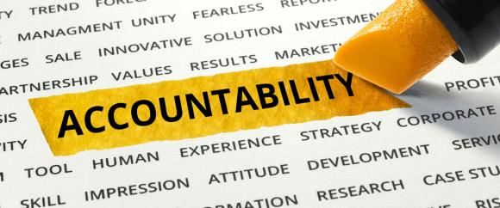
Brent Gleeson outlines several traits of a high performing and accountable team. Take each of the following topics and discuss (a) the meaning, (b) the challenges and (c) the possibilities.
https://www.youtube.com/watch?v=clwM5-Dao9A&pbjreload=10
Alignment
Feedback
Extreme ownership
Consistency
Follow through

Slide 27
The Science of Character
Session - 6
The intent of this session is to use the platform of science to create a conversation on the best practices to develop character.
In your own words, define character and have a transparent discussion on the art and science of building character in RMTs.

Slide 28
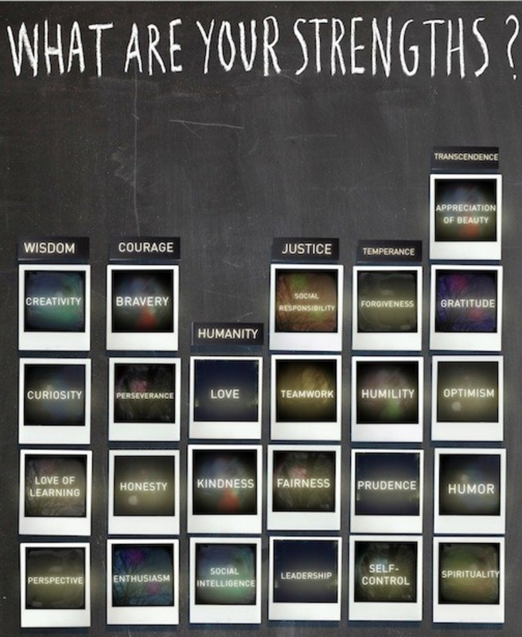

Slide 29
https://www.youtube.com/watch?v=U3nT2KDAGOc&pbjreload=10
2. After reviewing the above ted talk on the science of character, explain your thoughts.
3. Explain what is meant by a fixed mindset and growth mindset. Which mindset best describes you and why?
4. What is self regulation and explain the pro and cons. What role, if any, does spirituality have in self-regulation?
5. “Watch your thoughts. They become words. Watch your words. They become deeds. Watch your deeds. They become habits. Watch your habits. They become character. Character is everything.” Thoughts?
6. Review the previous slide and share with the group your top three character strengths.

Slide 30
The Character of Collaboration
Session - 7
The intent of this session is to explore the best practices
of collaboration in an organization.
Describe a time when you saw collaboration at its best and worst on a team. Be sure to identity the traits of both.

Slide 31
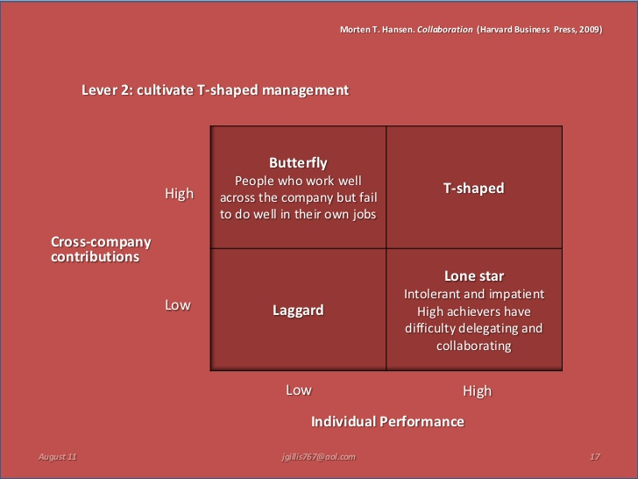

Slide 32
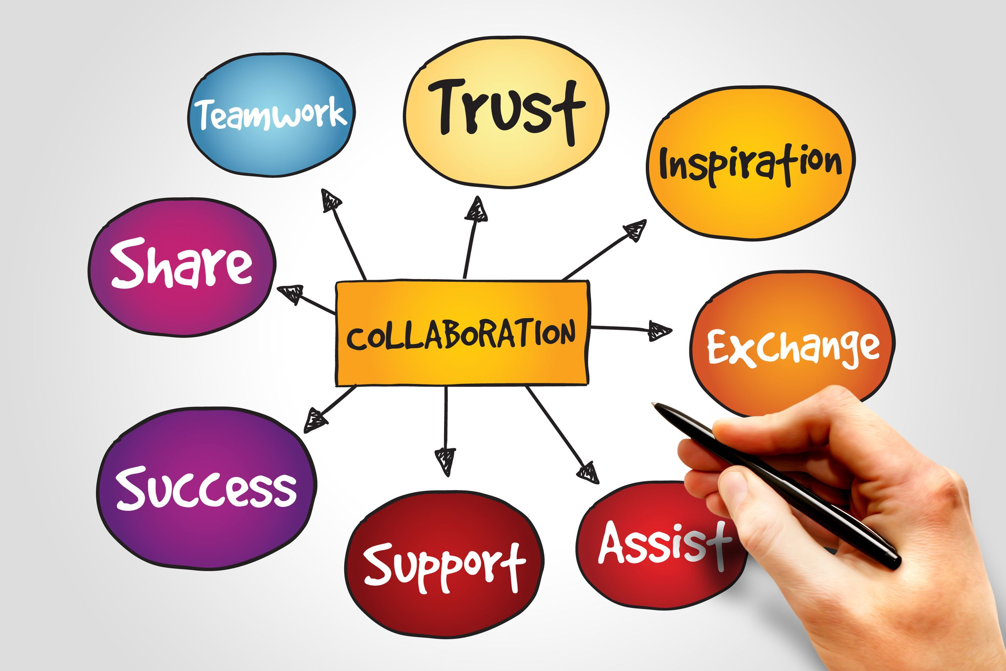
https://www.youtube.com/watch?v=vjSTNv4gyMM
Describe your overall impression of the above Ted Talk.
In your opinion, which best describes the conditions in the fleet – Red Zone or Green Zone? What about the CHC – red zone or green zone? Explain your logic.
Discuss the meaning of managing one’s own defensiveness.
Discuss the most common signs of defensiveness and how it impacts an organization.
Discuss the Tamm principle to mitigate defensiveness. Do you agree? What should be included or removed?

Slide 33
The Character of Toughness
Session - 8
The intent of this session is to explore the best practices to build toughness in RMTs.
In your own words, define toughness and select a statement that best represents your belief. (a) RMTs are tough and are ready for combat at sea, (b) RMTs have an average level of toughness and will do ok in combat at sea (c) RMT toughness is low and will not do well at combat at sea. Explain your why.

Slide 34
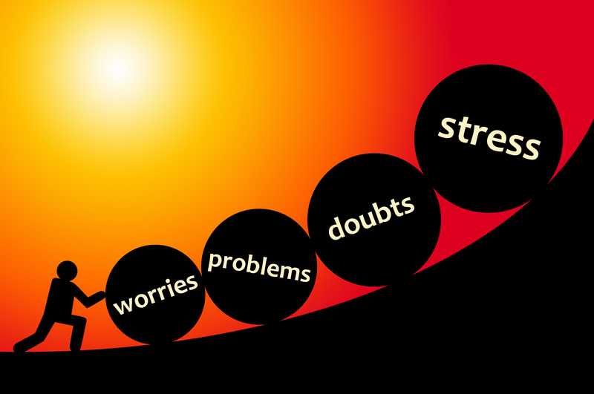
https://www.youtube.com/watch?v=H14bBuluwB8&pbjreload=10
After viewing the above Ted Talk, have a conversation with the below in mind.
In your opinion, why is IQ the main measurement for success? Do you agree?
What is Grit? How can grit best be built in the fleet? Explain.
Does talent make you gritty? Explain.
Develop a growth mindset model that will build tougher RMTs and send to the CoC office at the consideration.

Slide 35
The Character of Connection
Session - 9
The intent of this session is to explore the best practices to build healthier and authentic professional connections in RMTs.
Lane three of the navy Leader Development Framework 3.0 states that, “…Personal connections strengthen out character and resilience by building relationships. We share what we experience, and seek to understand what’s going on in other’s lives. Not only in mind, but in body and spirit as well…” What are your thoughts?

Slide 36

https://www.youtube.com/watch?v=iCvmsMzlF7o&t=636s&pbjreload=10
After viewing the above Ted Talk, have a conversation with the below in mind.
What is meant by telling the story about self without fear? Is this easy and how can we get better?
What does it mean to be authentic?
Embracing vulnerability can be translated to mean “you go first” with letting down your guards. If this is true, what are the implications for leaders?
Ms. Brown mentioned a Spiritual awakening – what are the requirements and can this be healthy?

Slide 37
Have a discussion on the “symptoms” of not being vulnerable and some possible cures. At the completion of the discussion, explain how the CHC can help the fleet with “connection.”
  The symptoms
  We numb vulnerability (emotion)
  Certain the uncertain
  We perfect
  We pretend
Cures
Let ourselves be seen
Love with out whole hearts
Practice gratitude
Know that I am enough

Slide 38
Called To Serve
Session - 10
The intent of this session is to explore the best practices of
cultivating a culture of servant leadership in RMTs.
Called to serve is the moto of the CHC. In your own words, describe your understanding of this saying. As you explain, wrestle with the question, “How did you develop your leadership style and is it healthy?”

Slide 39
https://www.youtube.com/watch?v=lmyZMtPVodo&pbjreload=10
After viewing the above Ted Talk, have a conversation with the below in mind.
What is meant be the saying, “the leader sets the tone?”
How important is the variable of safety and should leaders be feared? Explain.
“Good” parents want the following things for their children - opportunity, education, discipline when required and for them to achieve more than we did. Simon Sinek argues this is the work of a leader. Is he right? Explain.
Explain if the Next Jump model (i.e. coaching to improve performance) could /should work in RMTs.
Leaders eat last – what does this mean and how can we better model this saying?

